Slide 1
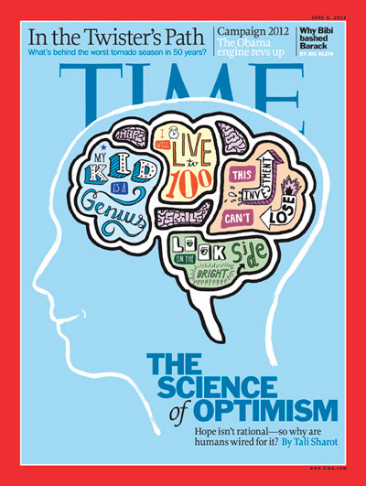
Manas K Mandal

Slide 2

After studying very hard for your semester exam, you haven’t done well. While you are good, you would like up to the next level
How likely are you to each of the following?
Look over the test to see what questions you got wrong & work on those
Decide there is no point to studying so hard if you don’t get the result you want
Keep on studying & trying to improve your results on the next exam
Blame the disappointing results on a bad test
Compare your grades with other students
@Manas K Mandal
ACT Tessera

Slide 3
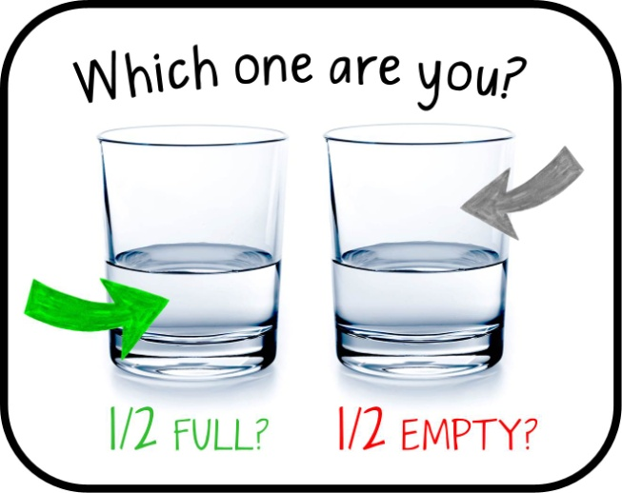
The Science of Optimism
Trait or dispositional optimism: People who have a tendency to expect a future that is more positive than negative. Good things will happen to me
Explanatory optimism: A style of explaining negative events by referring to specific external causes that will likely change over time. You lose money in stock market but think market is crazy right now. You will do better when it settles down

Slide 4

The Science of Optimism
Strategic optimism: These people distract themselves & don’t dwell on a potentially stressful event coming up. That upcoming public speech – you don’t give much thought until it comes up & you feel prepared
Optimistic bias: The tendency to think that you are better at something than other people. Bad things are more likely to happen to other people & good things are likely to happen to you. I am a better driver than others

Slide 5
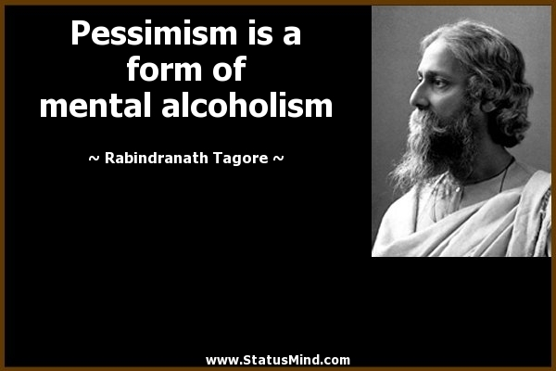
The Science of Pessimism
Trait or dispositional pessimism: People who have a chronic tendency to expect a negative future. My future is dim
Explanatory pessimism: A style of explaining why bad things happens & that faults yourself or reasons that are not going to change. You lose money in the stock market & consider yourself a stupid

Slide 6
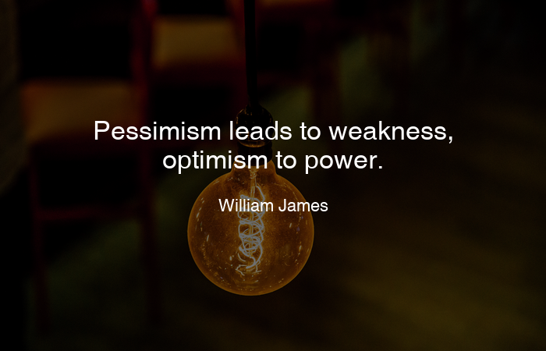
The Science of Pessimism
Defensive pessimism: A strategy to manage anxiety by lowering expectations & anticipating what could go wrong in a potentially stressful manner. You are preparing for a public lecture & think that the slide show may break down
Pessimistic bias: The tendency to think that you are worse at something than other people. You expect more bad things & fewer good things. I am horrible on the road…so defer to other drivers

Slide 7
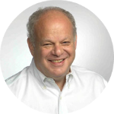
Learned Optimism: Martin Seligman, UPenn
Positive psychology aims to discover & promote conditions that enable individuals to thrive
Based on learned helplessness & attributional style theories
Optimists make external, variable & specific attributions for failure
Pessimists make internal, stable & global attributions for failure

Slide 8
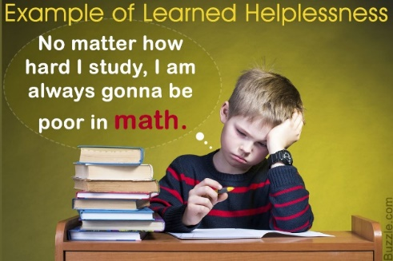
Learned helplessness:
The passive resignation produced by repeated exposure to negative events that are perceived to be unavoidable
Uncontrollable bad events lead to perceived lack of control which culminate into helpless behavior like:
We can’t change the course of negative events
Failure is inevitable & insurmountable
It’s a response to failure & not to success
It’s a control problem & not a competence problem

Slide 9
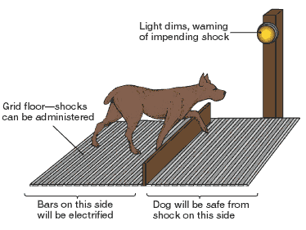
Learned optimism:
33% of the dogs could not be taught to become helpless

Slide 10
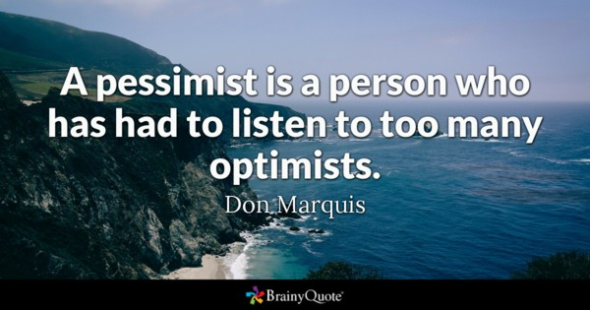
Attributional thinking style
Personal : its all my fault
Personal: it might be hard, I would better plan
Pervasive: It will affect all aspects of my life
Pervasive: I want to make changes or get out
Permanence: It will never change
Permanence: Things will improve in days to come

Slide 11
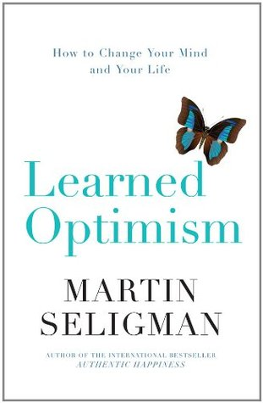
The Science of Optimism: Research findings
Strong negative relationship between optimism & depression
Optimism moderates thoughts of burdensomeness
Optimism has high correlation with self-esteem
Optimism improves immune system
Optimists have better coping strategies to deal with adversities

Slide 12
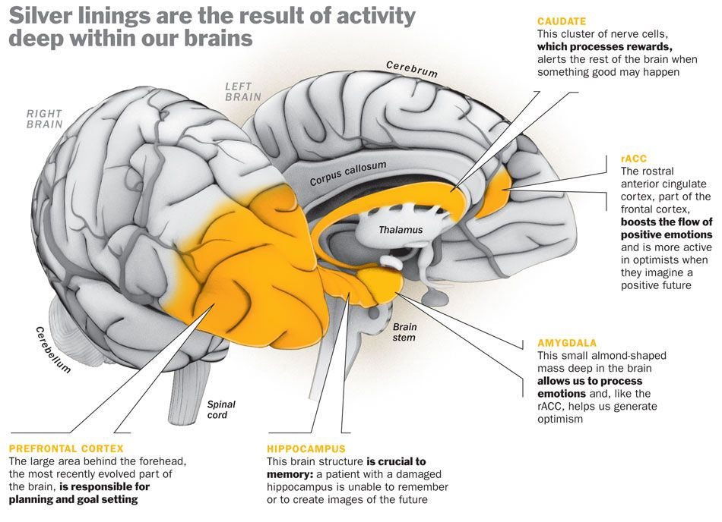

Slide 13
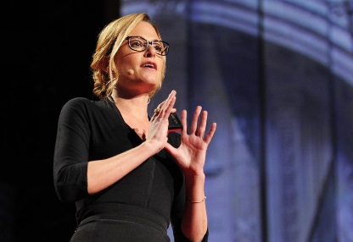

Optimism bias...(Tali Sharot, 2011)
a cognitive bias that causes a person to believe that they are at a lesser risk of experiencing a negative event compared to others
Expecting to live longer than objective measures would warrant
Overestimate our success in job market
Believe that our children will be especially talented

Slide 14
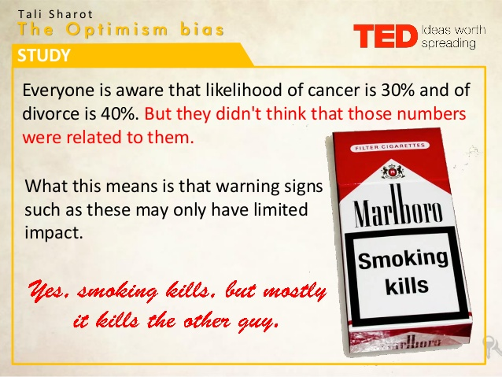

Slide 15
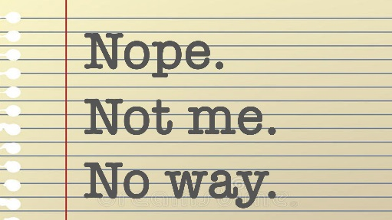
Optimism bias…positive consequences
Optimism bias is maintained despite disconfirming evidence in normal people & is adaptive in nature
People update their beliefs more in response to positive than negative information
Healthy brain exhibits mechanisms that create optimistic belief (reward center), & is constantly reshaped by future
Expecting positive outcome reduces stress & anxiety
Optimists live longer

Slide 16
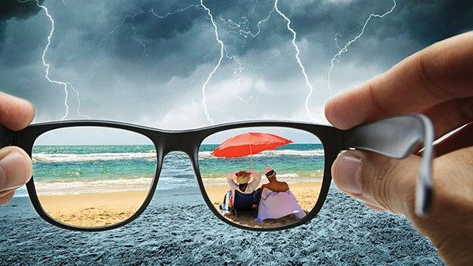
Optimism bias…negative consequences
The bias changes objective reality
Underestimating risk reduces precautionary behavior like buying medical insurance
Promote harmful behavior like over-eating, smoking
It attributes to temporal discounting (over-valuing present over the past) like rewarding at present but costly in future
Collective biases create havoc like financial downfall in 2008

Slide 17
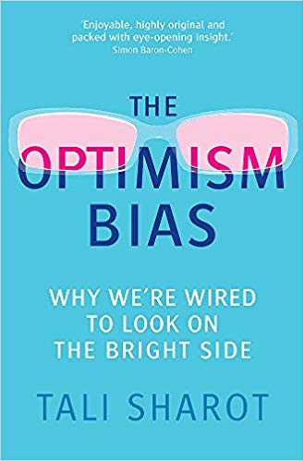
Optimism bias…when it increases
When things or events are thought to be under individual’s direct control
When there is a sense of uncertainty
When there is selective inattention to perceived risk

Slide 18
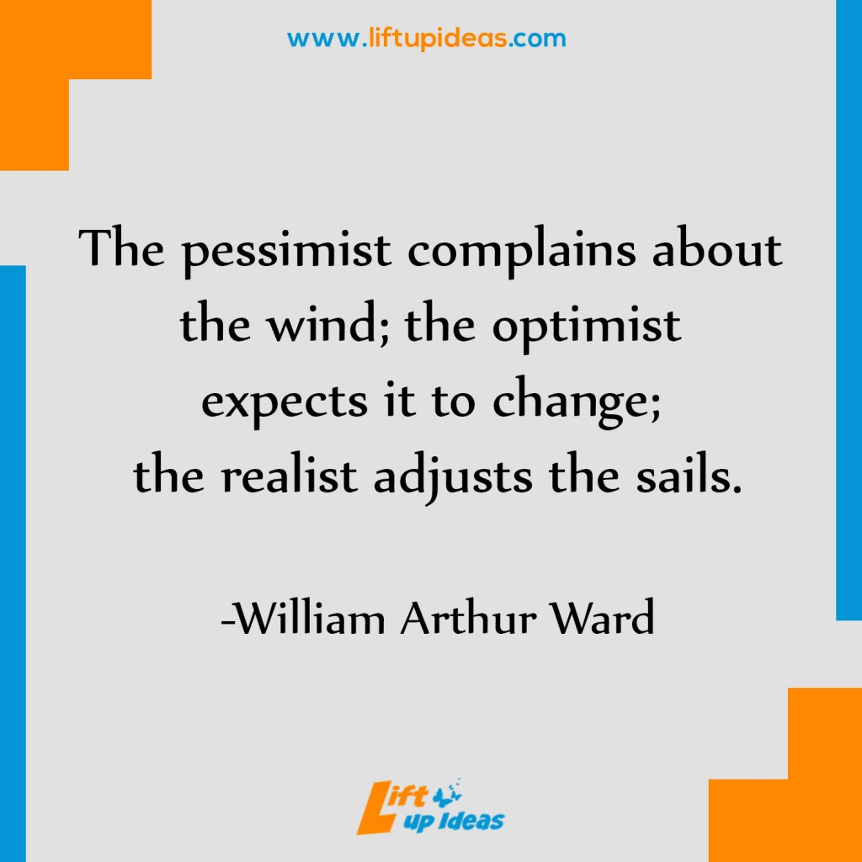

Slide 19
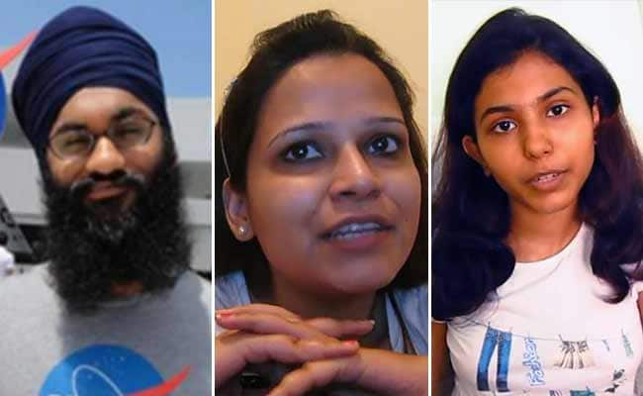

Who are they?

